Slide 1
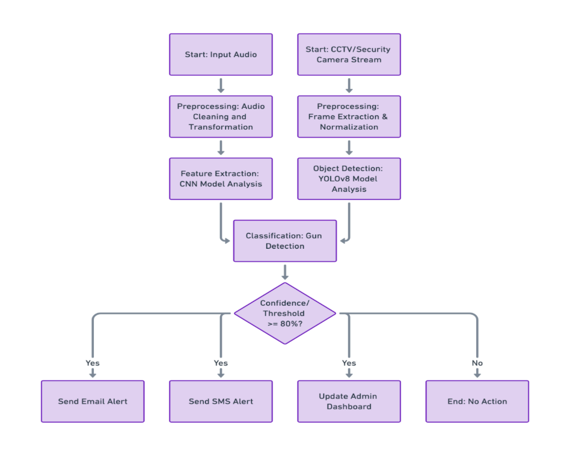

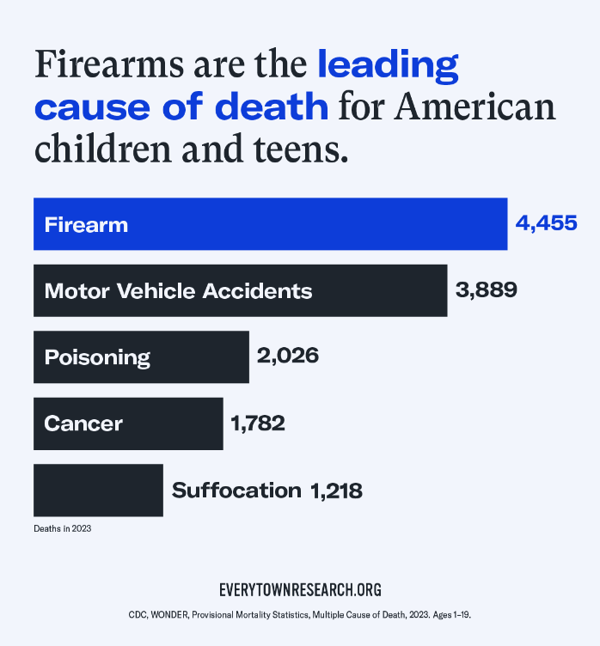
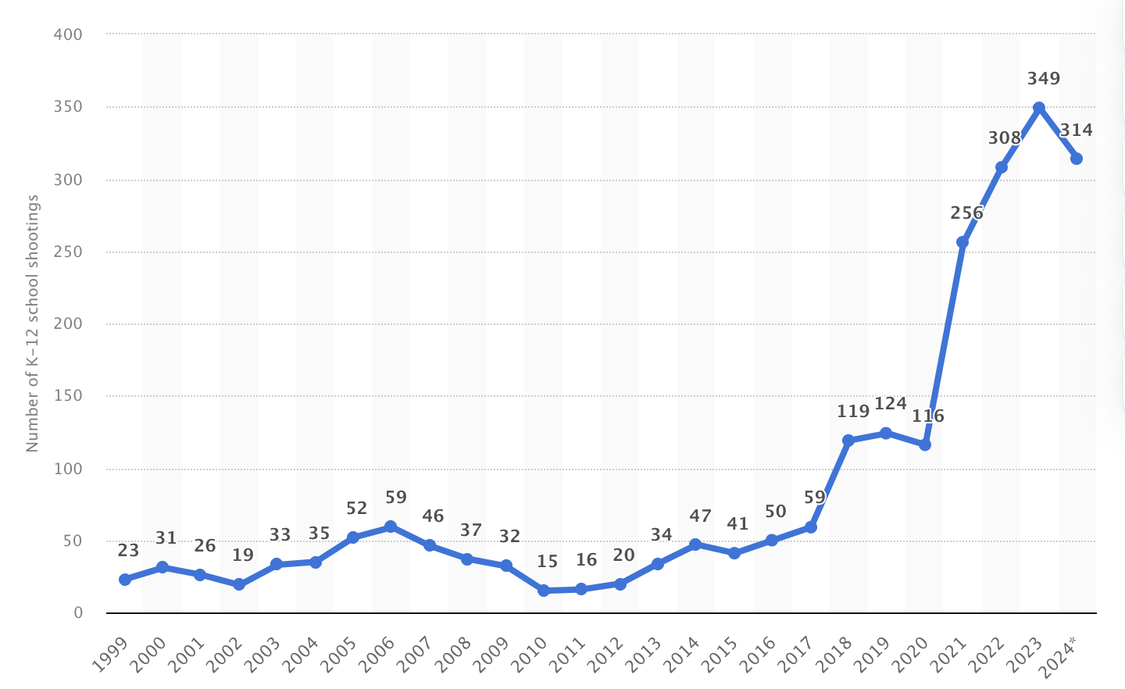
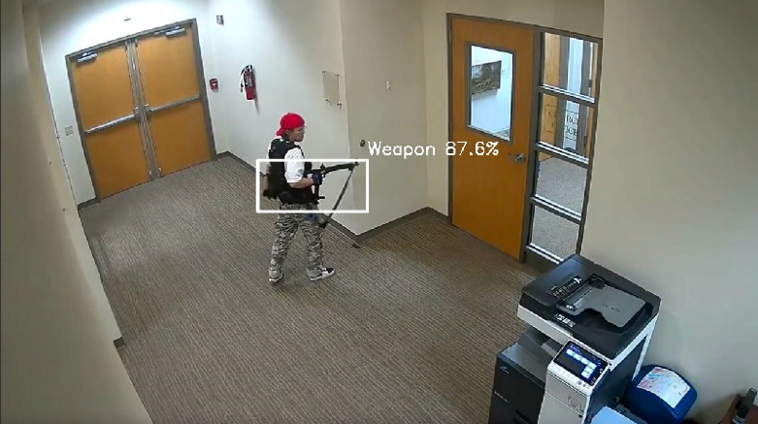
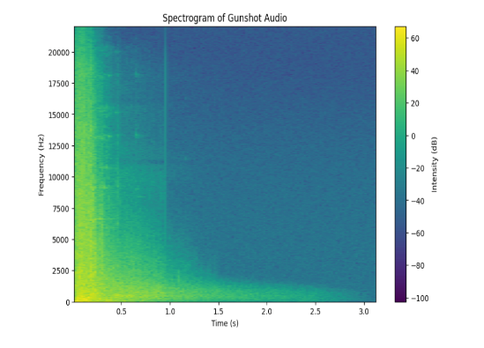
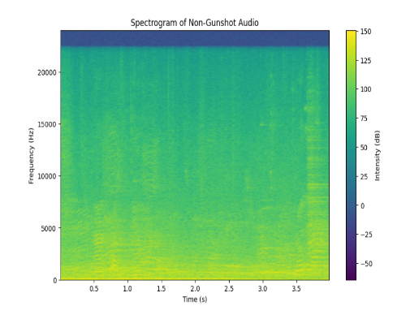
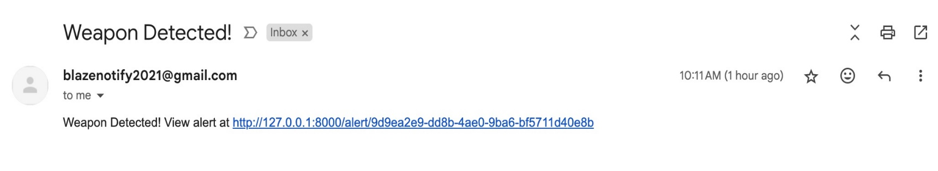
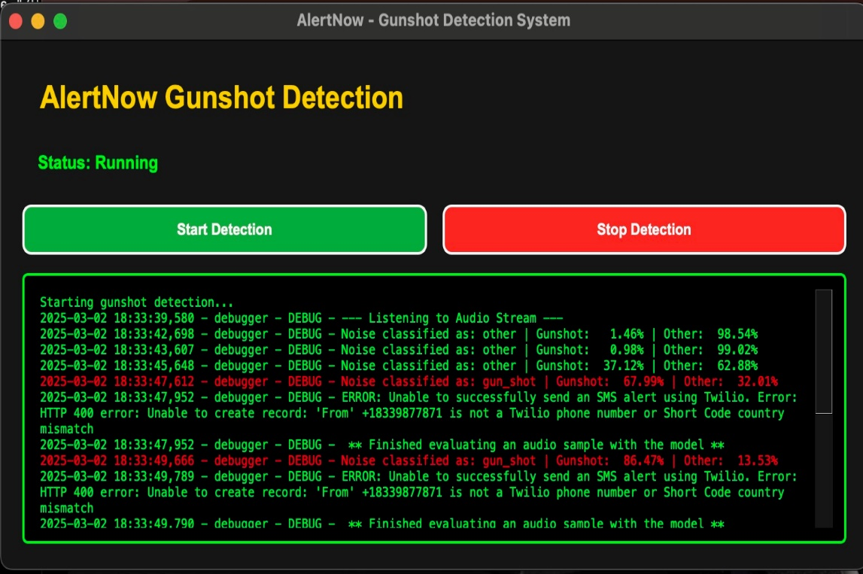
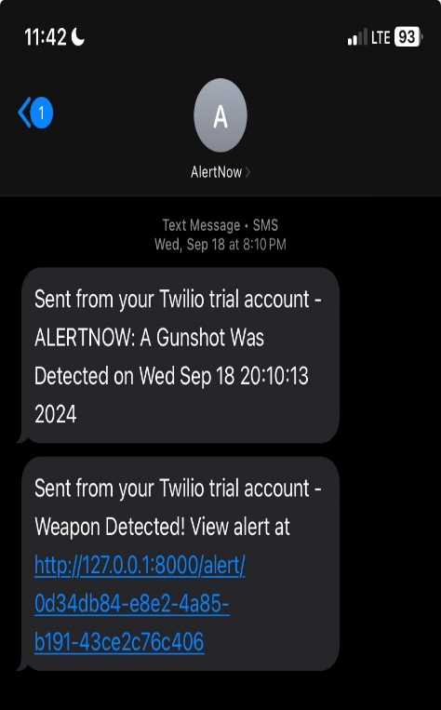
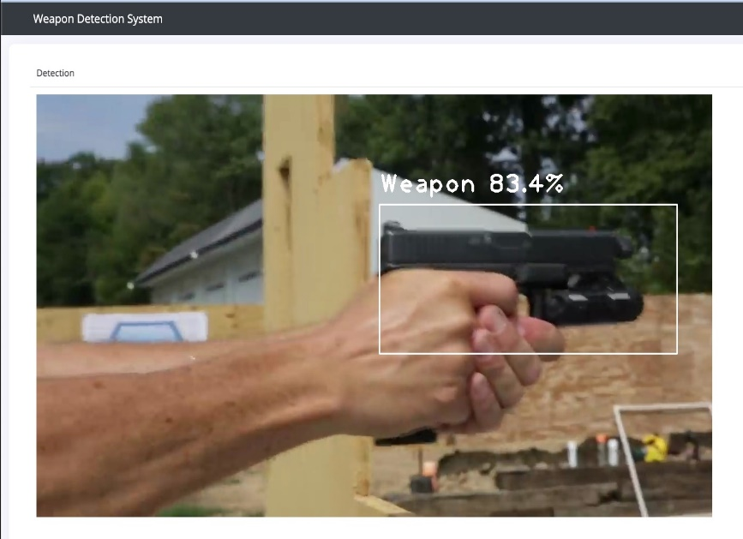



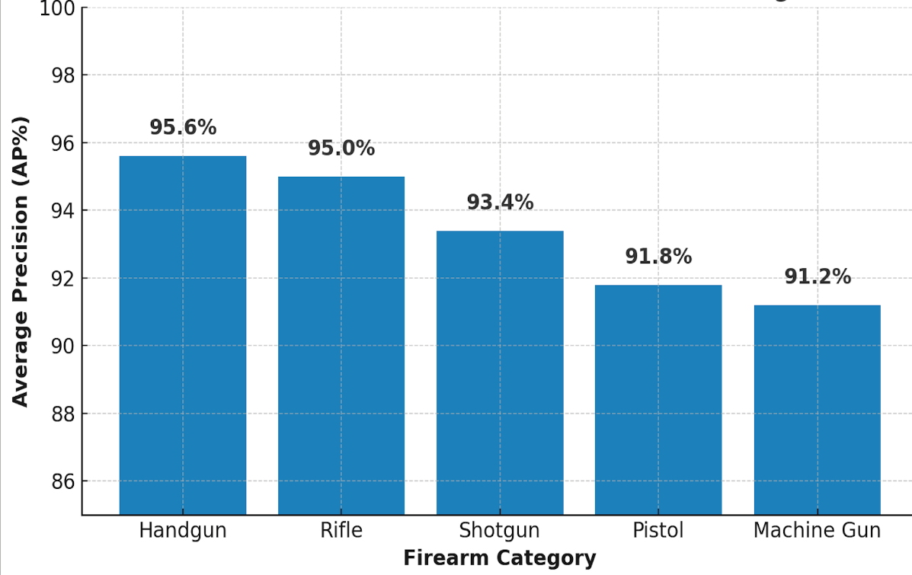
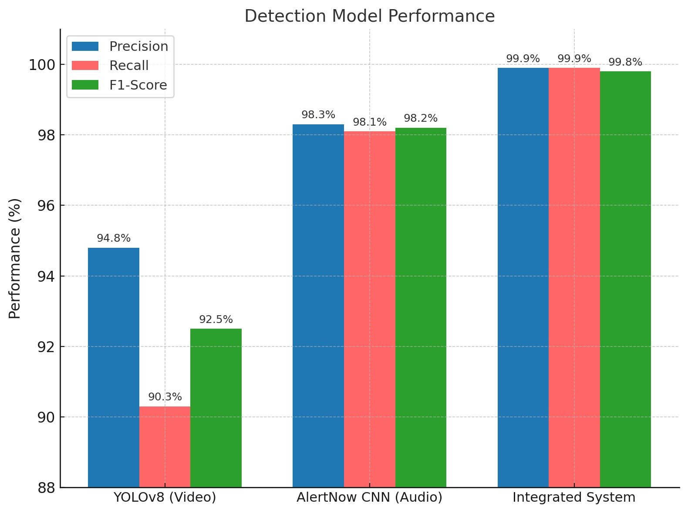
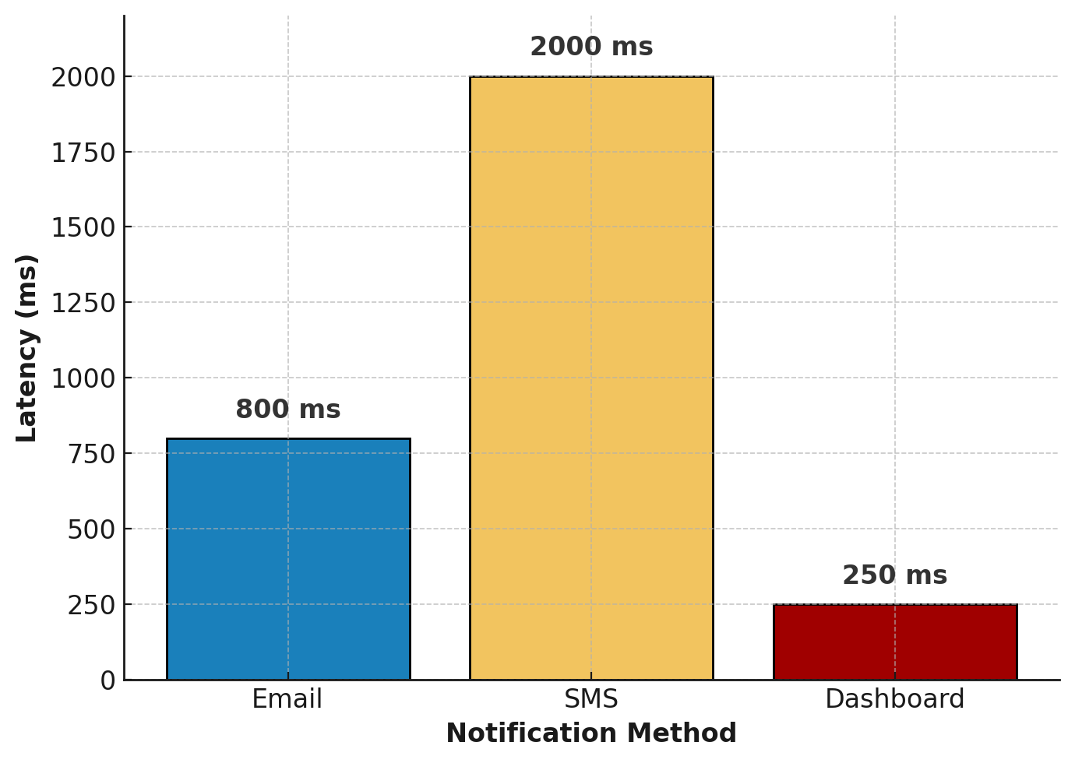
AlertNow: A Real-Time, Low Cost, Multi-Modal Fusion System to Detect
Gun Threats in US Schools
INTRODUCTION
METHODOLOGY
CONCLUSION
Gun violence has become a dangerous epidemic in the United States.
Step 1: Dataset Selection & Preprocessing
Step 2: Model Training &
Evaluation
Step 3: System Integration with Real-Time Alerts
Multi-Modal Fusion for Enhanced Accuracy: AlertNow integrates CNN for audio analysis and YOLOv8 for video detection, ensuring real-time, precise firearm identification.
Each year, it kills over 45,000 people and injures twice as many — a 34% increase in gun related deaths over the last decade.
In 2024 alone, there have been at least 83 school shootings, and gun violence costs the nation an estimated $557 billion annually.
Video Dataset
Audio/Video Model Selection
High Performance: Outperforms standalone models and existing systems, achieving 99%+ precision, recall, and F1-score while maintaining low-latency alerts.
❗️The U.S. gun homicide rate is 26 times higher than that of other high
Category | Pre-augmented Training Dataset | Un-augmented Validation Dataset | Un-augmented Testing Dataset
Handgun | 2968 | 774 | 774
Rifle | 2475 | 645 | 645
Shotgun | 1979 | 516 | 516
Pistol | 1484 | 387 | 387
Machine Gun | 991 | 259 | 259
Training: Pre-augmented dataset of 9,897 annotated images from Roboflow and Kaggle
Validation & Testing: Dataset of 5,162 un-augmented images
Dataset split: 80% Training, 10% validation, 10% Testing; Dataset priority - Handguns
CNN was chosen over Long Short-Term Memory (LSTM) networks and SoundNet. CNN showed superior performance in pattern recognition, effectively processing audio signals, faster training times, and better scalability across various hardware platforms.
YOLOv8 was chosen over EfficientNet and ResNet50 due to its superior performance in real-time applications. YOLOv8 demonstrated high precision, ease of use, speed, and accuracy, making it optimal for the firearm detection task.
income countries.
❗️ Firearms are now the leading cause of death for American children
and teens — surpassing motor vehicle accidents.
Easy Integration: Designed to integrate with existing school surveillance systems using standard CCTV cameras and microphones.
❗️ Gun-related incidents in K–12 schools have surged in recent years.
❗️ 1 in 4 children in America witness gun violence - leaving trauma lasting
lifetime.
Preprocessing
YOLOv8 Bounding Box w/ Confidence Score
Audio/Video Training Parameters
Frames extraction, Image resizing, Pixel normalization
Learning Rate: 0.001 - Step size for updating model weights during training
Batch Size: 16 - Number of training samples processed before updating the model
Epochs: 100 - Number of times the entire dataset is passed through the model
Cost-Effective & Scalable: Provides enhanced security without expensive infrastructure changes, leveraging existing surveillance systems, making it practical for schools.
Audio Dataset
Category | Training Dataset | Validation Dataset | Testing Dataset
Gunshot | 3323 (32%) | 415 (4%) | 415 (4%)
Non-Gunshot (Fireworks, jackhammer, machinery) | 4985 (48%) | 623 (6%) | 624 (6%)
Training: 10,385 sound samples (each < 4 seconds) from Kaggle; 40% gunshot and 60% non-gunshot sounds
Dataset split: 80% Training, 10% validation, 10% Testing
Impact: AlertNow offers a reliable, cost-effective, and real-time solution for firearm detection, giving schools a critical tool to respond quickly and protect students.
Data Augmentation
CNN Spectrogram Representation
Gun homicide rate in the United States vs. other countries
Firearm deaths vs other causes among youth in the Unites States
Source: Statista 2025
Pitch alteration
2 second clip duration
Spectrogram Analysis
Background noise addition
Alert Notification Examples – EMAIL, SMS, ADMIN DASHBOARD
K-12 school shootings in the United States from 1999 to December 9, 2024
FUTURE WORK
PROBLEM
Performance Evaluation Metrics
🛑 Traditional CCTV 📹:
🛑 Modern gun detection systems:
Performance Evaluation Metrics | Gunshot Detection Model (CNN) | Firearm Detection Model (YOLOv8)
Accuracy | ✓ | -
Precision | ✓ | ✓
Recall | ✓ | ✓
F1-Score | ✓ | ✓
Intersection over Union (IoU) | - | ✓
Average Precision (AP) | - | ✓
Mean Average Precision (mAP) | - | ✓
Notification Latency Rate | ✓ | ✓
Spectrogram Representation of GUNSHOT AUDIO
Spectrogram Representation of NON-GUNSHOT AUDIO
AlertNow Integrated System Application & SMS Alert
Real-World Evaluation: Deploy AlertNow in live school surveillance systems by integrating it with existing CCTV infrastructure and optimizing its performance to evaluate reliability, accuracy, and responsiveness in detecting gun-related threats.
❌ Requires human monitoring
❌ Reactive, not proactive
❌ No real-time threat detection
❌ Lacks integration with
⚠️ Limited to a single modality
💰 High operational cost
Mathematical Model for AlertNow’s Integrated Performance
AlertNow Dashboard
🖼️ ZeroEyes™️ (visual-only) costs ~$100K/year (contract dependent)
🔈ShotSpotter™️ (audio-only ) costs $65K–$90K/sq. mile/year
AlertNow’s multi-modal system performance is based on the classifier combination technique proposed by Kittler et al. [6]. This approach calculates the integrated detection probability using fundamental probability theory, ensuring optimal firearm and gunshot detection.
Integration with CCTV: Connecting the system to live CCTV streams will provide a more comprehensive assessment of detection capabilities, latency, and real-time alert effectiveness.
emergency response system
P^{Combined} = 1 - (1 - P^{YOLOv8}) * (1 - P^{CNN})
Where:
P^{YOLOv8} = Probability of firearm detection by YOLOv8
P^{CNN} = Probability of gunshot detection by CNN
✔️ Need - A cost-effective, real-time, multi-modal gun detection system integrating both audio and video analysis for improved accuracy and faster response.
The AlertNow application captures sounds and images and processes them through the trained CNN and YOLOv8 models. With a confidence score of 80% or higher, the system automatically triggers an alerts through Email, SMS, and Dashboard Update for immediate response.
System Optimization: If current CCTV coverage or audio input is inadequate for accurate gunshot detection, assess the option of upgrading or repositioning microphones and cameras to enhance system accuracy and overall performance.
HYPOTHESIS
RESULTS
YOLOv8 Model Performance Across Firearm Categories
Performance Comparison: YOLOv8 vs. Prior Models
Performance Comparison: CNN vs. Prior Models
KEY REFERENCES
Integrating a Deep Learning-based audio and video analysis model into a multi-modal detection system will improve the accuracy of firearm and gunshot detection and reduce response time compared to single-modality systems, enabling faster real-time alerts for school security.
Firearm Category | Number of Images | AP (%) | mAP (%) @ 0.5 IoU
Handgun | 774 | 95.6% | 93.4%
Rifle | 645 | 95.0%
Shotgun | 516 | 93.4%
Pistol | 387 | 91.8%
Machine gun | 259 | 91.2%
Performance Evaluation Metrics | YOLOv3 Model Results [8] | Scaled YOLOv5 Model Results [4] | YOLOv7 Model Results [9] | AlertNow YOLOv8 Model Results
Precision (%) | 85 | 99.5 | 94.6 | 94.8
Recall (%) | 81 | 84.6 | 85.6 | 90.3
F1-Score (%) | 83 | 91.4 | 89.9 | 92.5
mAP@0.5 (%) | - | - | 94.7 | 93.4
Performance Evaluation Metrics | Morehead et.al. [7] KERAS Model Results |  |  |  | AlertNow CNN Model Results
 | 1D CNN | 2D CNN (64) | 2D CNN (128) | CNN Ensemble
Accuracy (%) | 99.4 | 99.4 | 99.4 | 99.5 | 98.7
Precision (%) | 98.0 | 97.1 | 97.4 | 97.9 | 98.3
Recall (%) | 96.6 | 97.6 | 97.6 | 98.0 | 98.1
F1-Score (%) | 97.3 | 97.4 | 97.5 | 97.9 | 98.2
Matthews, A., O’Kruk, A., & Choi, A. 2024. School shootings in the US: Fast facts. CNN. [Online].
Goold, B.J. (2004). CCTV and Policing: Public Area Surveillance. Oxford University Press.
Piza, E.L., Welsh, B.C., & Farrington, D.P. 2019. CCTV Surveillance for Crime Prevention: A 40-Year Review. Criminology and Public Policy, 18(1), 135–159.
Ashraf, A.H., Imran, M., & Qahtani, A.M. 2022. Weapons Detection Using CNN and YOLO-V5s. Computers, Materials and Continua, 70(2), 2716–2775.
Wang, C., Bochkovskiy, A., & Liao, H.M. 2022. YOLOv7: Trainable Bag of Freebies Sets New State-of-the-Art for Real-Time Object Detection. arXiv.
Kittler, J., Hatef, M., Duin, R. P., et al. 1998. “On Combining Classifiers.” IEEE Transactions on Pattern Analysis and Machine Intelligence, 20(3), pp. 226-239.
Morehead, A., Ogden, L., Magee, G., et al. 2019. “Low-Cost Gunshot Detection using Deep Learning on the Raspberry Pi.” IEEE International Conference on Big Data, pp. 3038–3044. https://doi.org/10.1109/BigData47090.2019.9006456
Garza, J.I., and Vega, C.A."Gun detection in video frames with YOLOv3," December 2021. https://www.researchgate.net/publication/356683717_Gun_Detection_in_Video_Frames_with_YOLOv3
Houser, T., McMillan, A., Dong, B. 2024. “Bridging the Gap Between Criminology and Computer Vision: A Multidisciplinary Approach to Curb Gun Violence.” Security Journal, volume 37, pp. 1409–1429.
OBJECTIVE
Develop AlertNow, a reliable, cost-effective, multi-modal system for real-time detection of gunshots and firearms. Utilizing Deep Learning models for audio and video analysis, AlertNow integrates with existing CCTV surveillance systems to detect threats and deliver immediate alerts for rapid response and improved school safety.
mAP @ 0.5 IoU represents the model's mean Average Precision at a 50% Intersection over Union threshold.
📌 While YOLOv7 achieves the highest mAP (94.7%), YOLOv8 significantly improves Recall (90.3%), reducing missed detections.
📌 The AlertNow CNN model achieves the highest F1-Score (98.2%), with strong Precision (98.3%) and Recall (98.1%).
📌 The model achieved an overall mAP of 93.4%, with AP scores exceeding 91% across all firearm categories.
📌 This demonstrates reliable firearm detection, confirming model’s effectiveness for real-world security applications.
📌 YOLOv8’s higher F1-Score (92.5%) makes it highly reliable for real-world security applications.
📌 While prior CNN models achieved slightly higher Accuracy, the AlertNow model maintains a competitive edge in overall detection reliability.
TOOLS AND TECHNOLOGIES
Performance Comparison: Integrated AlertNow System vs. Individual YOLOv8 and CNN Models
AlertNow Notification System: Real-Time Performance
Performance Evaluation Metrics | AlertNow YOLOv8 Model Results (P^{YOLOv8}) | AlertNow CNN Model Results (P^{CNN}) | Integrated AlertNow System Estimated Theoretical Combination Results P^{Combined} = 1 - (1-P^{YOLOv8}) * (1-P^{CNN})
Precision (%) | 94.8 | 98.3 | 99.9
Recall (%) | 90.3 | 98.1 | 99.8
F1-Score (%) | 92.5 | 98.2 | 99.8
The AlertNow system was tested on 3,620 samples (2,581 images, 1,039 audio files), demonstrating low latency with average notification times of 800ms (email), 2000ms (SMS), and 250ms (dashboard updates). It achieved a 100% delivery rate for detections achieving 80% confidence threshold or more, with no false alerts.
AlertNow was developed and tested on 2022 MacBook Pro (M2 chip).
Models: CNN (Convolutional Neural Network) model for audio analysis to detect gunshot sounds, and a YOLOv8 (You Look Only Once version 8) model for video analysis to detect firearms.
Hardware: Audio Input - Built-in MacBook microphone & Logitech USB microphone (20 Hz - 20 kHz), Video Input - MacBook FaceTime 1080p HD camera (45 FPS)
Software: Machine Learning - Python, TensorFlow, PyTorch, Ultralytics; Audio Processing – Librosa, SciPy, PyAudio; Video Processing – OpenCV; Data Handling – NumPy; Backend/API - Django, Django REST Framework, Gunicorn; Notification System - Twilio, smtplib; Graphical User Interface - PyQt5
ACKNOWLEDGEMENTS
📌 By integrating visual detection (YOLOv8) and audio-based gunshot detection (CNN), the AlertNow multi-modal fusion system maximizes accuracy while minimizing false positives and missed detections.
📌 It achieves near-perfect performance with Precision (99.9%), Recall (99.8%), and an F1-Score (99.8%), significantly outperforming individual models and making it highly effective for real-world security applications.
I extend my sincere gratitude to my mentor for her invaluable mentorship and guidance. I also honor the courage of survivors and the resilience of families affected by gun violence, whose strength continues to inspire my commitment to this cause.
This research paper has been accepted for publication in the 2025 Institute of Electrical and Electronics Engineers (IEEE) Xplore Digital Library
*Actual delivery times may vary due to network congestion

